Slide 1
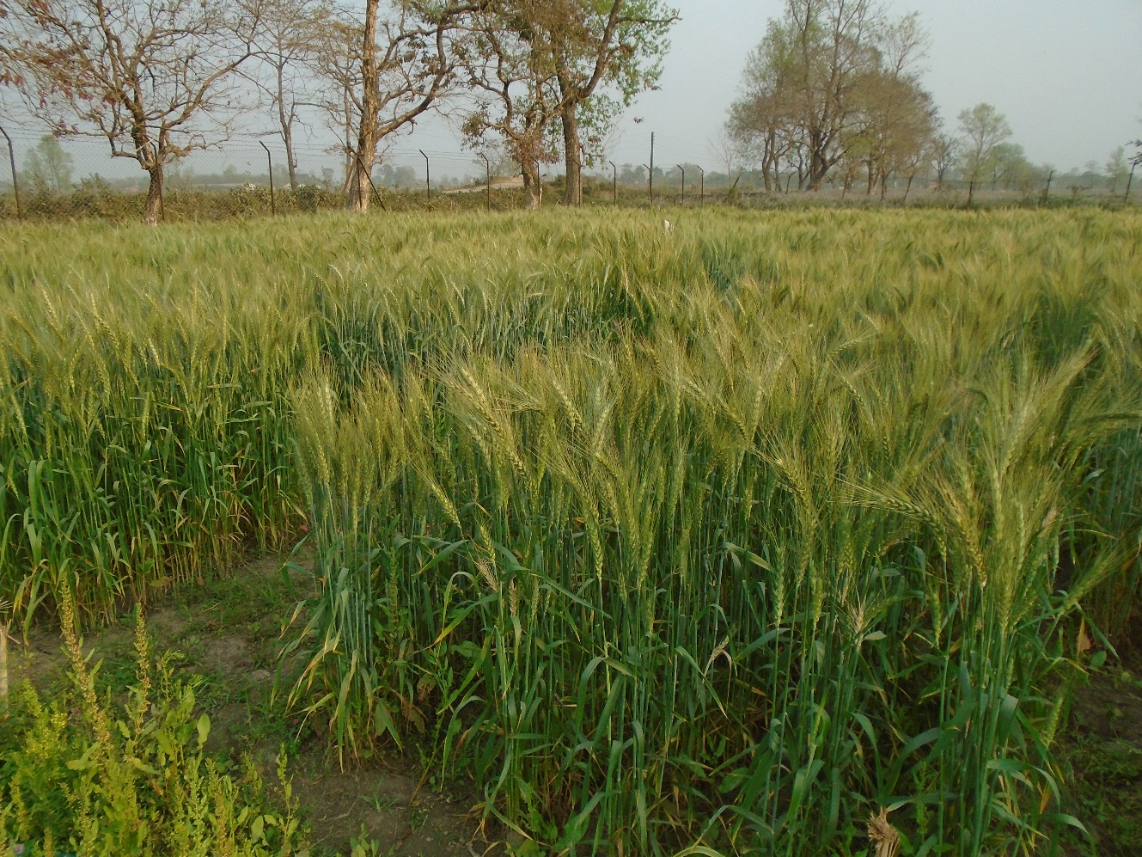
Welcome

Slide 2
POST-ANTHESIS LEAF HEALTH AS POTENTIAL DETERMINANT OF YIELD IN EARLY EVALUATION TRIAL OF WHEAT GENOTYPES
Deependra Dhakal
Agriculture and Forestry University
Department of Genetics and Plant Breeding
Rampur, Chitwan
Major Advisor:
Prof. Madhav Prasad Pandey, PhD
Department of Genetics and Plant Breeding
Committee Members:
Senior Scientist Nutan Raj Gautam, NARC
Prof. Bishnu Raj Ojha

Slide 3
Introduction: Leaf health
At phenotypic level, genotypes may be typed as healthy or not by assessing their signs and symptoms expressed in response to stress.
Plant's performance given stress has often been ascribed to green and viable leaves contributing to photosynthesis during grain formation in wheat (Thorne 1982).
Ideally, the contribution of pre-anthesis photosynthetic reserves to the final grain yield has been found to stall around 5% to 10% (R. Sharma, 1992).
Terminal leaves, particularly the flag leaf and the one directly below it, have significant contribution to genotypic variation in yield (Aslam & Hunt, 1978) with respect to provisioning of assimilate to functionally active parts of plants including the storage organ(grain). This variation has been ascribed largely to the difference in the leaf longevity (Lupton, 1972).

Slide 4
Introduction: Leaf health
Breeding programs might benefit for yield improvement by targeting indicators of plant's healthy leaf area, as well as the time dependent changes that prolong photosynthetic capacity of a leaf (Lupton 1972).
Latter is often explained as the stay green(SG) trait– indicative of leaf longevity and expressed as decline in photosynthetically active chlorophyllous surface (A. Joshi et al. 2007).
Maintenance of green coloration by plants enables them to maintain lower canopy temperatures (M. Kumari et al. 2013) which may be less favorable for pathogens requiring relatively higher temperatures for faster growth and development.
Greenness trait is also implicated in genotypic variation conferring disease resistance, particularly those exhibiting foliar symptoms (A. Joshi et al. 2007).

Slide 5
Introduction: Spatial designs
Due to intrinsic nature of agricultural land and unattended sources of heterogenity, breeding materials are often tested under limited precision.
For a plant breeding program, early testing problem is to have to reliably discriminate among a large number of genetic resources, which are yet to be multiplied for a more thorough multi-environment evaluation.
An augmented design is where a randomized design trial having a certain fraction of the plots allocated to check cultivar is augmented with entries in some optimized design framework with partial or no replication at all (Piepho and Williams 2016; Federer and others 1994).
Augmented Row-Column Design, a much later addition, is a genre of optimal designs; they allow testing of arbitrarily large number of new cultivars, allow imposing a range of different blocking structures for dealing with additional forms of field heterogeneities and also enables robust fitting of parametric models.

Slide 6
Problem statement
Post-anthesis foliar health could be a proxy for determining final grain yield as it has direct implication on grain filling behavior of a plant.
Randomization based experimental designs with multidimensional blocking structures that accommodate large number of treatment entries in a study, could provide an efficient alternative to traditional block designs for testing numerous entries with fewer number of checks.

Slide 7
Objectives
To identify post-anthesis leaf health traits associated with yield
To analyze association between the post-anthesis leaf health and yield and yield component, crop morphological and phenological traits
To formulate yield prediction model based on post-anthesis leaf health
To identify superior genotypes with favorable variation for leaf health

Slide 8
Materials and Methods: Trial setup
Conducted under the natural epiphytotic condition (Application of insecticidal sprays and disease checking sprays avoided.)
Irrigation scheduled to best avoid pre-antheis moisture stress, as this has been implied in largest losses resulting in number of fertile florets and the final grain weight(Innes and Blackwell 1981).
The dominant soil type of the study site is medium to heavy textured loam.
Dimensions of the field
Individual plot size: 0.94 m²
Total Area: 351 m²
Net Plot Area: 225 m²

Slide 9
Materials and Methods: Trial setup
Date of sowing: Nov 24, 2016
Full rates of K₂O and P₂O₅ applied at the time of sowing.
Nitrogen applied in split doses(60 kg N ha−1 as basal and remaining 60 kg N ha−1 top dressed after irrigation.
Seed sown continuously within rows.
A row spacing of 25cm.
Sowing at a depth 3-5cm below the surface.
Weeding operations at least twice, interspersed throughout the growing season.

Slide 10
Materials and Methods: Trial setup
Number of rows(k): 12
Number of columns(s): 20
Number of checks(ν_{c}): 4
Number of row-groups(g_{k}): 3
Number of column-groups(g_{s}): 4
Number of new entries(v_{e}): 104
Number of plots allocated to checks per block(ν_{gkgs}): variable

Slide 11
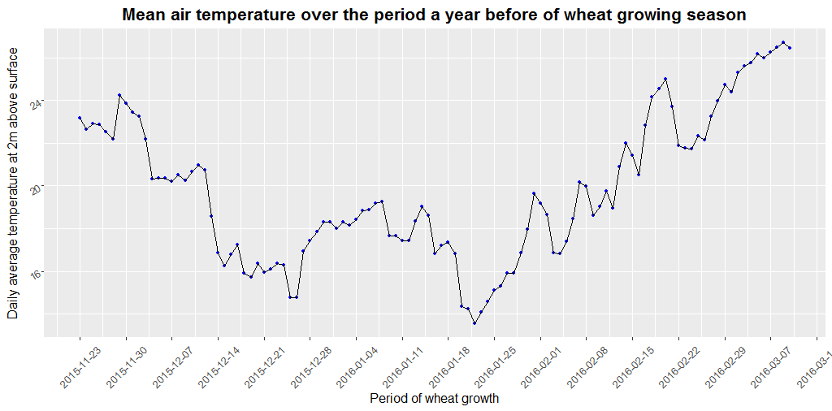
Materials and Methods: Study site temperature profile

Slide 12
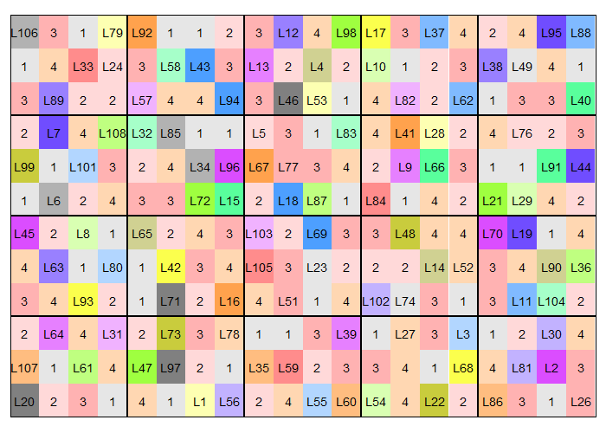
Materials and Methods: Randomized layout of the experimental design

Slide 13
Materials and Methods: Statistical analysis
Using linear mixed models with random effects for the row and column factors, entry genotypes, row-group, column-group, and rowgroup-columngroup interaction and fixed effects for check genotypes (Piepho and Williams, 2016).
A full model for a response y is of form:
y=μ+rowgroup+colgroup+rowgroup.colgroup+rowgroup.row+colgroup.col+genotype+ϵ
where, μ is the common intercept and ϵ is the residual plot error.
An augmented row-column design may be analysed considering spatial model for plot error(ϵ)(Clarke and Stefanova 2011).

Slide 14
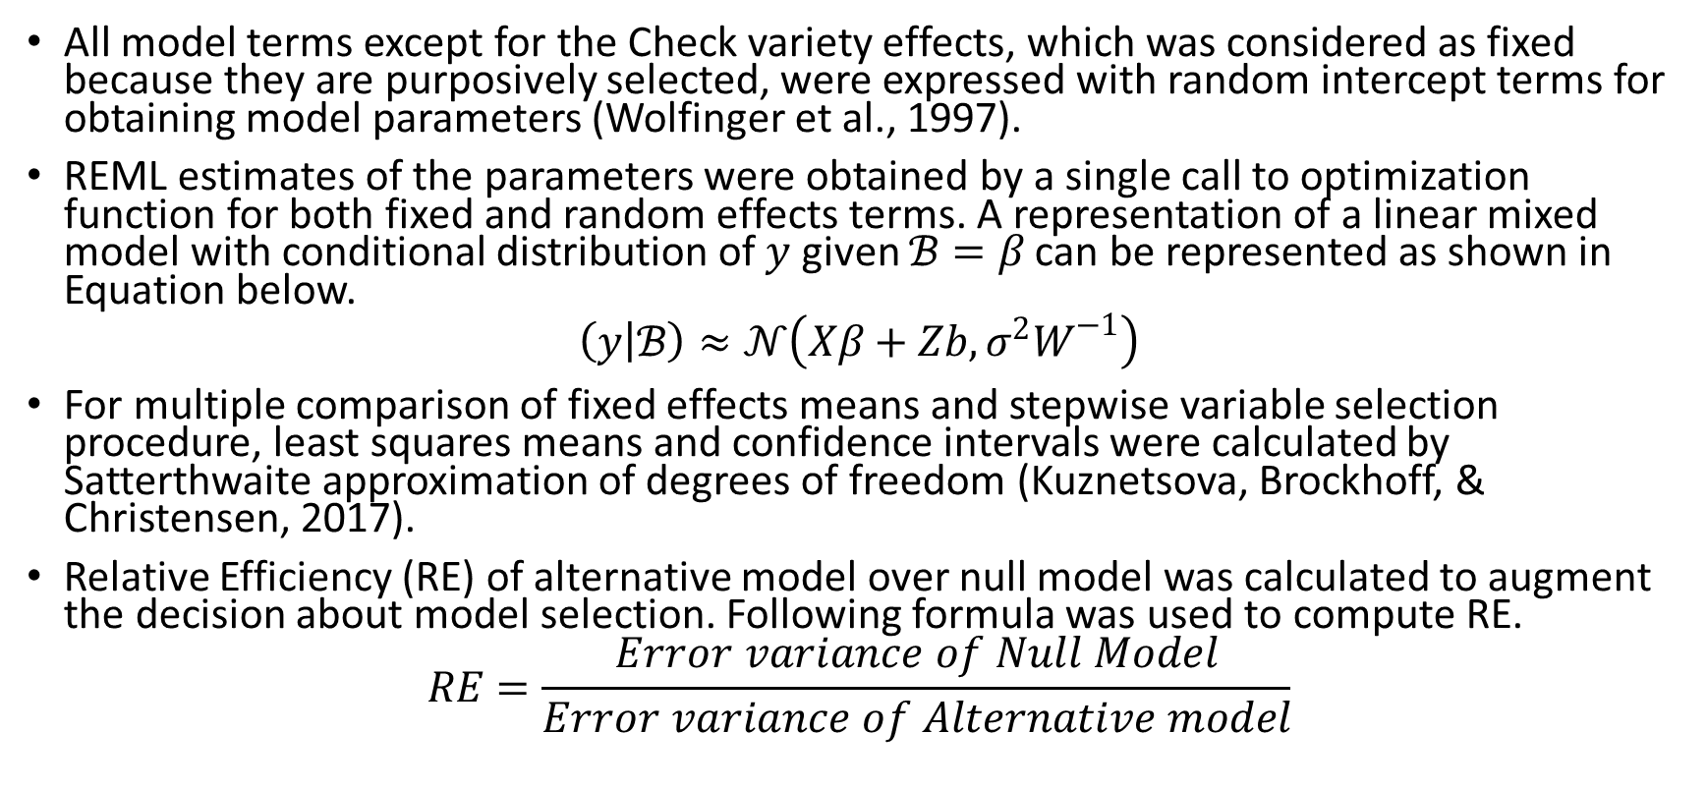
Materials and Methods: Statistical analysis (…continued)
All model terms except for the Check variety effects, which was considered as fixed because they are purposively selected, were expressed with random intercept terms for obtaining model parameters (Wolfinger et al., 1997).
REML estimates of the parameters were obtained by a single call to optimization function for both fixed and random effects terms. A representation of a linear mixed model with conditional distribution of $y$ given $ℬ=β$ can be represented as shown in Equation below.
$$\left(y | ℬ\right)≈𝒩\left(Xβ+Zb,σ^{2}W^{−1}\right)$$
For multiple comparison of fixed effects means and stepwise variable selection procedure, least squares means and confidence intervals were calculated by Satterthwaite approximation of degrees of freedom (Kuznetsova, Brockhoff, & Christensen, 2017).
Relative Efficiency (RE) of alternative model over null model was calculated to augment the decision about model selection. Following formula was used to compute RE.
$$RE=\frac{Error variance of Null Model}{Error variance of Alternative model}$$

Slide 15
Materials and Methods: Summary of check varieties used in Study
Characteristics | Tilottama | Bhrikuti | Gautam | Aditya
Year | 2014 | 1994 | 2002 | 2010
Breeding program | Nepal Agriculture Research Council | Nepal Agriculture Research Council | Nepal Agriculture Research Council | Nepal Agriculture Research Council
Synonym | NL 1073; NL1073; NL-1073; FRANCOLIN; FRANKOLIN |  | BL 1887; BL-1887, BL1887
Growth Habit | Spring | Spring | Spring | Spring
Variety Type | Bread Wheat | Bread Wheat | Bread Wheat | Bread Wheat
Semidwarf (Rht gene) | Yes | Yes | Yes
Grain color |  |  |  | White grain
Grain hardiness
Pedigree | WAXWING*2/VIVITSI | CONTESTADO/COCORAQUE F 75/3/POLLO//FURY/ANAHUAC F 75 | SIDDHARTHA/NG 8319//NL 297 or SIDHHARTHA/NG 8319//NL 297 | GS348/NL746//NL748
Selection history |  | NL 623 FR 2308-2F-1F-0F | NC 1838-4B-020B-020B-2B-0B
CID (Cross ID) |  | 251774
SID (Selection ID) |  | 0
Origin | Advanced line from CIMMYT | Advanced line from CIMMYT | Cross made in the country, one CIMMYT parent | Cross made in the country, no CIMMYT parents

Slide 16
Materials and Methods: Summary of check varieties used in Study
Characteristics | Tilottama | Bhrikuti | Gautam | Aditya
CIMMYT breeding line | FRANCOLIN
Genes
Selection Code |  | Line from CIMMYT, further local selection within country
Ug99 | Yes | No | No | No
Stem Rust | Yes
Yellow Rust | Yes
Leaf Rust | Yes
ME1 |  | Spring Wheat | Spring Wheat | Spring Wheat
ME2 |  | Spring Wheat | Spring Wheat
ME3
Production Conditions | Irrigated and semi-irrigated areas of Terai and inner Terai |  | Irrigated, both normal and late sown condition of whole Terai, Taar and foot-hills (<500 m); maturity 105-115; potential yield - 5t/ha | Terai, Tars and Lower Valleys up to 500 500 masl; maturity 118 days, yield potential 4.8 t/ha
Suitable megaenvironments | ME1 | ME1 , ME5 | ME1 , ME5 | ME1
Notes | Resistant to spot blotch. High tillering. Early maturing, stay green, excellent for bread and chapati.
Cultivated area |  | 153,055 (2011/12) |  | 38263 (2011/12)

Slide 17
Materials and Methods: Flag leaf health assessment
Greenness as the difference for 0-9 visual score of green coloration (chlorophyll) of flag leaf at anthesis (Zadoks stage 65), medium milk (Zadoks stage 75) and soft dough (Zadoks stage 85) stages. Leaf greenness scores was considered to group genotypes into classes as shown in Table:
For characterizing HLB associated damage, scoring was done only upto Zadok's stage S77 (Late milk stage). This is to acknowledge the fact that, after this stage the natural cycle of senescence confounds the effects that follow due to pathogen activity (Neupane et al. 2007).
Greenness score | Greenness rating
0-2.5 | non-green
2.5-5.0 | moderately non-green
5.0-7.5 | moderately green
7.5-9.9 | green
Disease score | Score rating
0-2.5 | very less affected
2.5-5.0 | less affected
5.0-7.5 | much affected
7.5-9.9 | very much affected

Slide 18
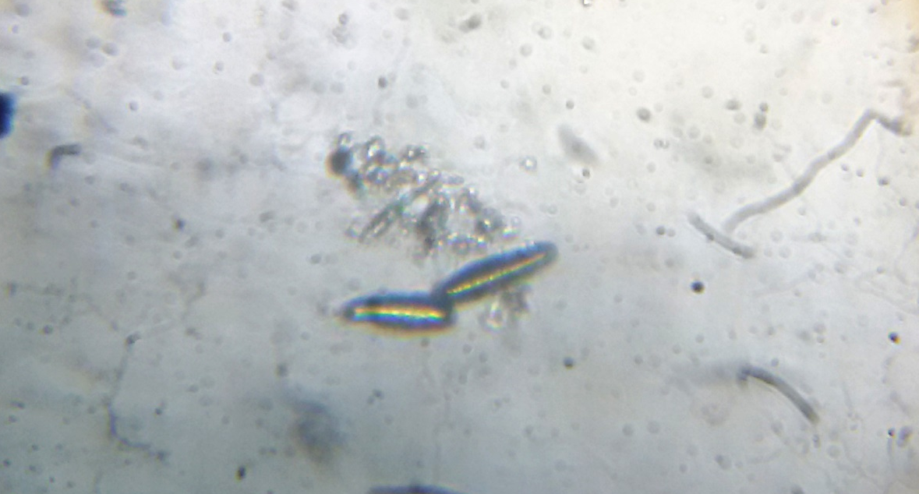
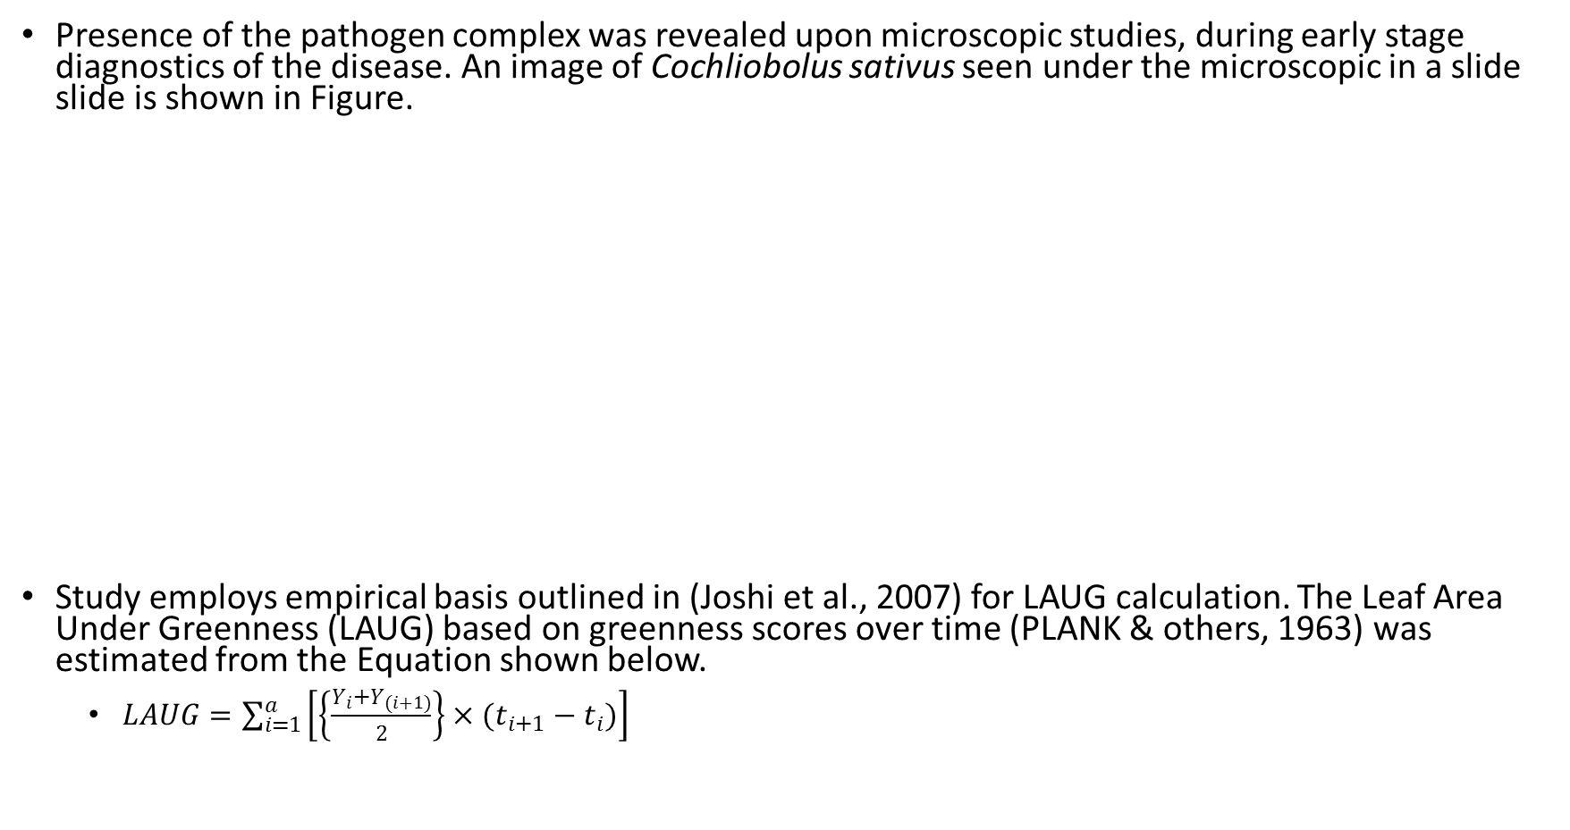
Methods and Methodology: Flag leaf health assessment
Presence of the pathogen complex was revealed upon microscopic studies, during early stage diagnostics of the disease. An image of Cochliobolus sativus seen under the microscopic in a slide slide is shown in Figure.
Study employs empirical basis outlined in (Joshi et al., 2007) for LAUG calculation. The Leaf Area Under Greenness (LAUG) based on greenness scores over time (PLANK & others, 1963) was estimated from the Equation shown below.
$LAUG=\sum_{i=1}^{a}{\left[\left\{\frac{Y_{i}+Y_{(i+1)}}{2}\right\}×(t_{i+1}−t_{i})\right]}$
Figure: Resolution of Cochliobolus sativus under microscope

Slide 19
Methods and Methodology: Field records of crop yield, morphology, phenology, and soil and atmospheric conditions
Observation | Stage recorded
Days to heading | When approximately 50% of the plants in a plot are at Zadoks stage 55
Canopy temperature depression | Anthesis (Zadoks stage 65)
Flag leaf greenness rating I | Anthesis (Zadoks stage 65)
Soil plant analytical development | Anthesis and soft dough (Zadoks stage 65 and 85)
Disease score | Anthesis and Late milk (Zadoks stage 65 and 77)
Days to anthesis | when approximately 50% of the plants in a plot are at Zadoks stage 65
Leaf area | Medium milk (Zadok stage 75)
Plant height | Medium milk (Zadok stage 75)
Weed score | Medium milk (Zadok stage 75)
Number of effective tillers | Medium milk (Zadok stage 75)
Flag leaf greenness rating II | Medium milk (Zadok stage 75)
Flag leaf greenness rating III | Soft dough (Zadoks stage 85)
Defective heads count | Ripening (Zadoks stage 90)
Panicle length | Ripening (Zadoks stage 92)
Days to maturity | Ripening (Zadoks stage 92)
Number of grains per panicle | After harvested
Thousand kernel weight | After harvested and dried
Grain yield | After harvested and dried

Slide 20
Results and Discussion: Yield and yield component traits
encoding | Genotype | Yield | Effective tillers | Thousand kernel weight | Grain per panicle | Panicle length
1 | Aditya | 3.02 | 26.7 | 36.3 | 27.1 | 16.3
2 | Bhrikuti | 3.55 | 30.2 | 37.7 | 26.8 | 16.8
3 | Gautam | 3.33 | 27.1 | 38.5 | 28.3 | 17.5
4 | Tilottama | 3.42 | 33.7 | 36.1 | 27.4 | 16.6
L1 | MUNAL #1 | 4.07 | 27.0 | 35.9 | 28.8 | 16.6
L10 | MUNAL/3/HUW234+LR34/PRINIA//PFAU/WEAVER/4/... |  | 36.0 |  |  | 16.6
L101 | PFAU/MILAN/5/CHEN/AEGILOPS SQUARROSA (TAUS)/... | 3.28 | 30.0 | 43.6 | 27.7 | 16.4
L102 | PREMIO/5/TUI//2*SUNCO/SA1166/3/TUI/4/FINSI/... | 2.88 | 35.0 | 39.1 | 21.1 | 13.7
L103 | PREMIO/BAVIS |  | 47.0 |  |  | 15.0
L104 | CHIYAK//ND643/2*WAXWING/3/ND643/2*WAXWING |  | 30.0
L105 | BABAX/LR42//BABAX*2/4/SNI/TRAP#1/3/KAUZ*2/... | 4.15 | 38.0 | 41.5 | 26.9 | 17.1
L106 | PFAU/MILAN//TROST/3/MUNAL #1/4/PFAU/MILAN//... | 4.46 | 27.0 | 44.2 | 29.4 | 16.6
L107 | YUK/AE.SQUARROSA (217)//2*PANDORA | 2.51 | 30.0 | 39.4 | 22.3 | 13.8
L108 | SUP152*2//ND643/2*WAXWING | 3.44 | 36.0 | 41.5 | 28.1 | 12.9
L11 | SWSR22T.B./5/KAUZ//ALTAR 84/AOS/3/KAUZ/4/... |  | 28.0
L12 | WHEAR/VIVITSI//WHEAR/3/PANDORA | 3.68 | 33.0 | 46.5 | 30.7 | 15.7
L13 | WBLL1*2/KURUKU//TACUPETO F2001*2/BRAMBLING | 4.17 | 28.0 | 49.6 | 29.5 | 17.9

Slide 21
encoding | Genotype | Yield | Effective tillers | Thousand kernel weight | Grain per panicle | Panicle length
L14 | PASTOR/3/VORONA/CN079//KAUZ/4/MILAN/OTUS//.. | 2.85 | 39.0 | 33.8 | 26.9 | 15.9
L15 | FRANCOLIN #1*2/ND643/2*WBLL1 | 2.84 | 35.0 | 37.7 | 24.6 | 14.7
L16 | KIRITATI/ 2*WBLL1/3/TAM200/PASTOR//TOBA97/4/... | 3.83 | 31.0 | 44.1 | 30.6 | 18.6
L17 | SUP152/KENYA SUNBIRD |  | 33.0 |  |  | 15.9
L18 | SUP152/KENYA SUNBIRD | 3.43 | 37.0 | 37.7 | 26.5 | 13.3
L19 | SUP152/KENYA SUNBIRD | 3.74 | 35.0 | 32.0 | 30.9 | 14.2
L2 | KACHU #1 | 3.27 | 39.0 | 41.8 | 29.3 | 15.7
L20 | WBLL1*2/BRAMBLING/5/BABAX/LR42//BABAX*2/4/... |  | 26.0
L21 | ND643/2*WBLL1/3/KIRITATI//2*PRL/2*PASTOR/4/... |  | 34.0 |  |  | 16.3
L22 | BETTY/3/CHEN/AE.SQ//2*OPATA/4/BAVIS | 3.20 | 29.0 | 41.5 | 24.7 | 18.0
L23 | BAVIS/VORB/5/CROC_1/AE.SQUARROSA(205)//... | 2.58 | 23.0 | 45.8 | 23.4 | 15.0
L24 | BABAX/LR42//BABAX/3/ER2000/4/NAVJ07 |  | 39.0 |  |  | 17.7
L26 | NING-MAI-96035/FINSI//HEILO/3/NAVJ07 |  | 26.0
L27 | WBLL1*2/BRAMBLING//TAM200/TUI/3/... |  | 39.0 |  |  | 17.1
L28 | KISKADEE #1/5/KAUZ*2/MNV//KAUZ/3/MILAN/4/... | 4.10 | 47.0 | 39.8 | 22.6 | 14.9
L29 | MERCATO//PARUS/PASTOR |  | 31.0 |  |  | 16.5
L3 | KACHU/BECARD//WBLL1*2/BRAMBLING | 3.10 | 40.0 | 29.4 | 23.5 | 19.0
L30 | PREMIO//PARUS/PASTOR | 4.15 | 32.0 | 42.8 | 30.3 | 20.1
L31 | ND643/2*WBLL1//ND643/2*WAXWING | 3.81 | 37.0 | 46.9 | 23.9 | 16.3
L32 | ND643/2*WBLL1//ND643/2*WAXWING | 3.22 | 41.0 | 41.8 | 24.6 | 14.1
L33 | ND643/2*WBLL1//ND643/2*WAXWING |  | 41.0 |  |  | 16.7
L34 | SNB//CMH79A.955/3*CN079/3/ATTILA/4/CHEN/... |  | 32.0

Slide 22
encoding | Genotype | Yield | Effective tillers | Thousand kernel weight | Grain per panicle | Panicle length
L38 | BAJ #1*2/BECARD |  | 24.0 |  |  | 16.5
L39 | KACHU*2/MUNAL #1 | 2.72 | 28.0 | 46.8 | 23.5 | 14.1
L4 | PRL/2*PASTOR/3/PFAU/WEAVER*2//CHAPIO |  | 38.0
L40 | KACHU*2/MUNAL #1 | 3.20 | 27.0 | 36.0 | 21.8 | 14.4
L41 | KACHU/2*MUNAL #1 |  | 34.0
L42 | KACHU/2*MUNAL #1 |  | 33.0
L43 | KACHU*2/PANDORA | 4.36 | 50.0 | 48.0 | 23.5 | 17.0
L44 | SUP152/2*MUNAL #1 | 2.43 | 24.0 | 47.9 | 24.0 | 13.5
L45 | FRNCLN*2/BECARD |  | 35.0 |  |  | 17.1
L46 | WBLL1* 2/BRAMBLING//SAAR/2*WAXWING/4/... |  | 39.0 |  |  | 17.1
L47 | CHIBIA//PRLII/CM65531/3/MISR 2*2/4/... | 3.45 | 30.0 | 42.4 | 26.5 | 15.2
L48 | CHIBIA//PRLII/CM65531/3/MISR 2*2/4/... |  | 27.0 |  |  | 14.3
L49 | WAXWING/KRONSTAD F2004//2*FRNCLN | 3.49 | 36.0 | 29.4 | 31.9 | 17.4
L5 | DANPHE/CHONTE | 2.42 | 33.0 | 34.6 | 21.9 | 15.5
L51 | MUNAL #1/5/2*PRL/2*PASTOR/4/CHOIX/STAR/3/... |  | 27.0 |  |  | 13.3
L52 | MUNAL #1/5/2*PRL/2*PASTOR/4/CHOIX/STAR/3/... | 3.07 | 30.0 | 42.4 | 23.4 | 12.3
L53 | MUNAL #1/2*FRNCLN |  | 28.0
L54 | MUNAL #1/2*FRNCLN | 2.89 | 34.0 | 36.9 | 29.2 | 17.5
L55 | MUNAL #1*2//WHEAR/SOKOLL | 2.72 | 31.0 | 45.8 | 24.9 | 13.9
L56 | MUNAL #1*2/KINGBIRD #1 | 4.39 | 32.0 | 46.5 | 28.0 | 14.5
L57 | PRL/2*PASTOR//SUNSTATE/3/MUNAL #1/4/OTUS//... |  | 31.0 |  |  | 15.9
L58 | PRL/2*PASTOR//SUNSTATE/3/MUNAL #1/4/OTUS//... | 2.74 | 35.0 | 40.9 | 27.5 | 15.4
L59 | KAUZ*2/BOW//KAUZ/3/W98.6.38/5/SABUF/4/... |  | 26.0 |  |  | 16.4
L6 | SUP152/FRNCLN |  | 25.0

Slide 23
encoding | Genotype | Yield | Effective tillers | Thousand kernel weight | Grain per panicle | Panicle length
L60 | LERKE/5/KAUZ/3/MYNA/VUL//BUC/FLK/4/MILAN/6/... | 2.17 | 24.0 | 54.5 | 25.1 | 16.5
L61 | PASTOR/3/VORONA/CN079//KAUZ/4/MILAN/OTUS//... |  | 30.0 |  |  | 14.2
L62 | PASTOR/3/VORONA/CN079//KAUZ/4/MILAN/OTUS//... | 1.99 | 26.0 | 40.8 | 25.0 | 16.9
L65 | DOY1/AE.SQUARROSA (447)/3/KA/NAC//TRCH/4/... | 3.44 | 31.0 | 39.8 | 25.7 | 14.9
L66 | MON/IMU//ALD/PVN/3/BORL95/4/OASIS/2*BORL95/... |  | 32.0 |  |  | 16.8
L7 | MUU/FRNCLN | 2.40 | 25.0 | 44.9 | 26.3 | 18.9
L70 | TRCH/SRTU//KACHU/3/KINGBIRD #1 | 3.58 | 28.0 | 44.6 | 23.7 | 15.8
L71 | TRCH/SRTU//KACHU/3/KINGBIRD #1 | 3.98 | 47.0 | 42.7 | 22.8 | 15.2
L72 | TRCH/5/BAV92//IRENA/KAUZ/3/HUITES/4/DOLL |  | 26.0 |  |  | 15.6
L73 | BECARD #1/3/PBW343*2/KUKUNA//PBW343*2/KUKUNA | 3.87 | 35.0 | 39.7 | 28.8 | 16.4
L74 | DANPHE/3/PBW343*2/KUKUNA//PBW343*2/KUKUNA | 3.28 | 27.0 | 37.1 | 24.5 | 16.0
L76 | PBW343*2/KUKUNA//PBW343*2/KUKUNA/6/WBLL1*2/... | 3.36 | 33.0 | 42.7 | 25.7 | 14.3
L77 | BECARD/6/FRET2*2/4/SNI/TRAP#1/3/KAUZ*2/TRAP/... | 3.81 | 36.0 | 45.1 | 26.3 | 17.6
L78 | KACHU/6/YAR/AE.SQUARROSA (783)/4/GOV/AZ//... | 2.87 | 28.0 | 42.7 | 23.7 | 11.7
L79 | FRANCOLIN #1/NELOKI | 4.12 | 37.0 | 39.4 | 31.4 | 22.1
L8 | PRL/ 2*PASTOR/4/CHOIX/STAR/3/HE1/3*CNO79//... | 3.90 | 28.0 |  | 21.6 | 16.3
L80 | PAURAQ/8/NG8201/KAUZ/4/SHA7//PRL/VEE#6/3/... | 2.73 | 27.0 | 42.5 | 27.1 | 19.7
L81 | PRL/2*PASTOR//SUNSTATE/3/GRACK | 1.05 | 24.0 | 33.5 | 24.3 | 16.7
L82 | PICAFLOR #1/NELOKI | 3.63 | 40.0 | 37.9 | 24.4 | 16.8
L83 | PICAFLOR #1/8/NG8201/KAUZ/4/SHA7//PRL/VEE#6/... |  | 32.0 |  |  | 15.7
L84 | NL971*2/MUU | 3.83 | 46.0 | 35.5 | 25.2 | 15.6

Slide 24
encoding | Genotype | Yield | Effective tillers | Thousand kernel weight | Grain per panicle | Panicle length
L85 | MUNAL #1*2/4/HUW234+LR34/PRINIA//PBW343*2/... | 4.79 | 40.0 | 44.2 | 27.8 | 17.7
L86 | MUNAL #1*2/4/HUW234+LR34/PRINIA//PBW343*2/... | 4.15 | 26.0 | 41.6 | 26.0 | 15.7
L87 | MUNAL #1*2/4/HUW234+LR34/PRINIA//PBW343*2/... | 3.67 | 37.0 | 46.1 | 27.1 | 15.9
L88 | MUNAL #1*2/4/HUW234+LR34/PRINIA//PBW343*2/... |  | 23.0 |  |  | 16.5
L89 | BECARD #1*2/KINGBIRD #1 |  | 41.0
L9 | DANPHE #1*2/SHORTENED SR26 TRANSLOCATION | 3.14 | 36.0 | 34.9 | 28.9 | 16.3
L90 | BECARD*2/PFUNYE #1 | 2.91 | 41.0 | 38.2 | 28.0 | 16.2
L91 | PBW343/PASTOR//OTUS/TOBA97*2/3/PICAFLOR #1 | 1.27 | 28.0 | 35.1 | 24.9 | 15.9
L92 | ROLF07/KINGBIRD #1//MUNAL #1 | 4.68 | 34.0 | 38.2 | 29.2 | 16.4
L93 | MUNAL #1/3/PBW343*2/KUKUNA*2//YANAC | 4.83 | 30.0 | 43.1 | 26.2 | 15.3
L94 | SERI.1B*2/3/KAUZ*2/BOW/KAUZ/4/PBW343*2/... | 2.07 | 37.0 | 27.0 | 24.2 | 15.4
L95 | KAUZ//ALTAR 84/AOS/3/MILAN/KAUZ/4/SAUAL/5/... |  | 28.0 |  |  | 15.4
L96 | PBW343*2/KHVAKI//PARUS/3/PBW343/PASTOR/5/... | 1.88 | 18.0 | 37.1 | 22.7 | 15.5
L97 | FRET2*2/4/SNI/TRAP#1/3/KAUZ*2-TRAP//KAUZ*2/... | 1.46 | 27.0 | 32.5 | 26.4 | 15.9
L98 | ATTILA*2/PBW65*2//JUCHI/3/KINGBIRD #1/4/... |  | 27.0 |  |  | 19.5
L99 | MUNAL #1*2//WBLL1*2/BRAMBLING | 3.63 | 36.0 | 49.3 | 25.7 | 15.1

Slide 25
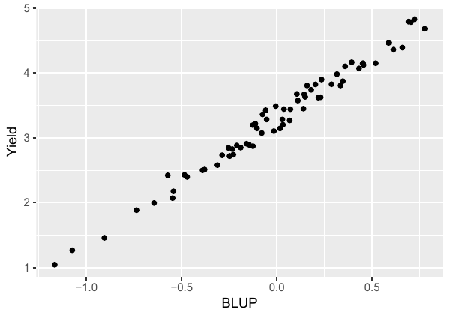
Results and Discussion: Observed values versus genotypic BLUP comparison of yield
The coefficient of determination between the observed and fitted values of random effects model is 0.61.
Table: Top ten best performing entry genotypes based on fitted yield (BLUPs) ranking with their yield estimates.
Entry genotype | Estimated yield | Genotype
L71 | 4.5 | TRCH/SRTU//KACHU/3/KINGBIRD #1
L67 | 4.38 | WHEAR/SOKOLL/4/PASTOR//MILAN/KAUZ/3/BAV92
L85 | 4.28 | MUNAL #1*2/4/HUW234+LR34/PRINIA//PBW343*2/...
L106 | 4.22 | PFAU/MILAN//TROST/3/MUNAL #1/4/PFAU/MILAN//...
L92 | 4.08 | ROLF07/KINGBIRD #1//MUNAL #1
L87 | 3.98 | MUNAL #1*2/4/HUW234+LR34/PRINIA//PBW343*2/...
L43 | 3.95 | KACHU*2/PANDORA
L1 | 3.94 | MUNAL #1
L84 | 3.93 | NL971*2/MUU
L105 | 3.89 | BABAX/LR42//BABAX*2/4/SNI/TRAP#1/3/KAUZ*2/...
Figure: Scatterplot of observed versus BLUP values of yield

Slide 26
Results and Discussion: Stepwise variable selection (Leaf health traits’ and check genotypes’ effects)
Trait variables | Sum Sq | Mean Sq | NumDF | DenDF | F.value | elim.num | Pr(>F)
SPADII | 0.016 | 0.016 | 1 | 170.3 | 0.065 | 1 | 0.798
Disease Z75 | 0.120 | 0.120 | 1 | 188.8 | 0.484 | 2 | 0.487
Greenness Z85 | 0.220 | 0.220 | 1 | 190.0 | 0.890 | 3 | 0.347
Check genotypes | 4.416 | 1.104 | 4 | 27.9 | 4.471 | kept | 0.006
Greenness Z65 | 4.385 | 4.385 | 1 | 170.4 | 17.755 | kept | 0.000
Greenness Z75 | 5.322 | 5.322 | 1 | 190.5 | 21.552 | kept | 0.000
LAUG 65_75 | 18.945 | 18.945 | 1 | 188.1 | 76.717 | kept | 0.000
SPADI | 3.134 | 3.134 | 1 | 187.2 | 12.689 | kept | 0.000

Slide 27
Results and Discussion: Stepwise variable selection (Design and treatment entries’ effect)
Random variables | Chi.sq | Chi.DF | elim.num | p.value
Random variables | Chi.sq | Chi.DF | elim.num | p.value
Nested col | 0.000 | 1 | 1 | 1.000
Rowgroup x Colgroup | 0.000 | 1 | 2 | 1.000
Nested row | 0.061 | 1 | 3 | 0.804
Rowgroup | 1.556 | 1 | 4 | 0.212
Colgroup | 8.560 | 1 | kept | 0.003
Line genotypes | 5.116 | 1 | kept | 0.024

Slide 28
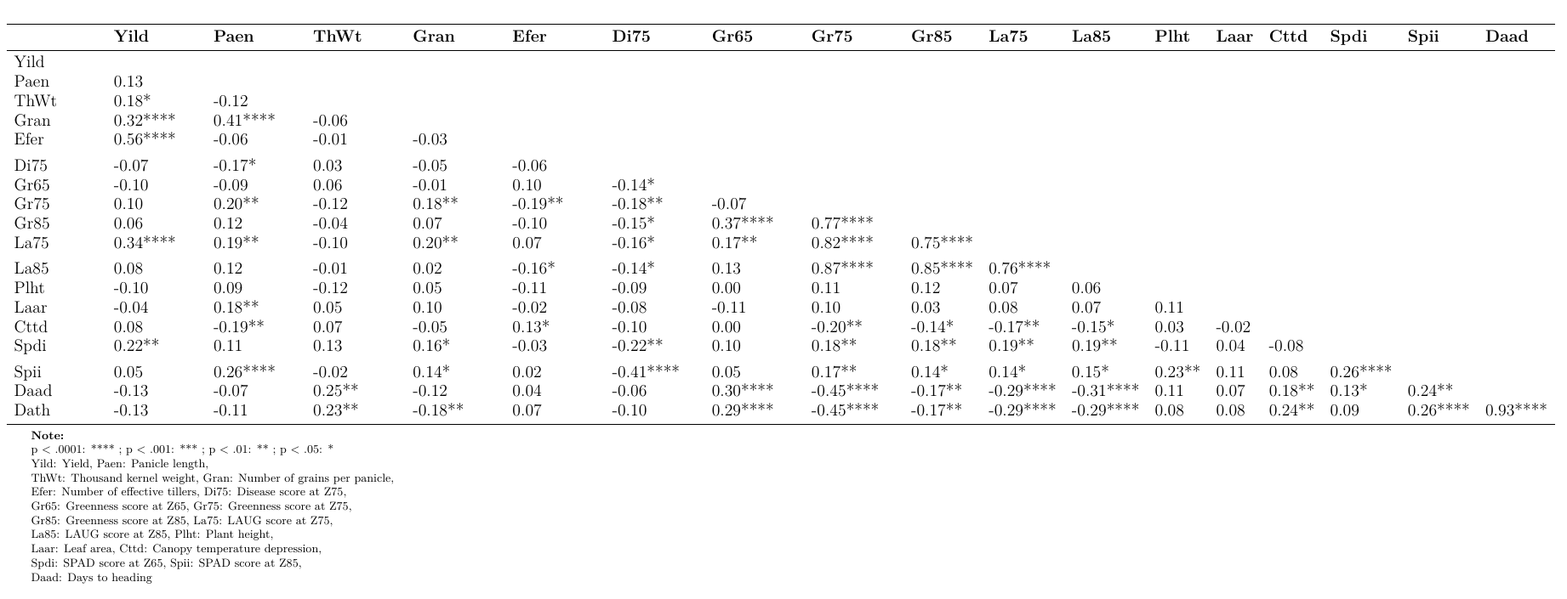
Results and Discussion: Pearson correlation coefficient between observed variables

Slide 29
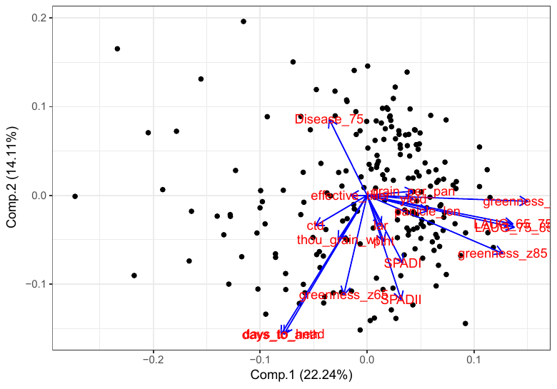
Results and Discussion: Dimension reduction
Figure: PCA biplot showing first two component axes

Slide 30
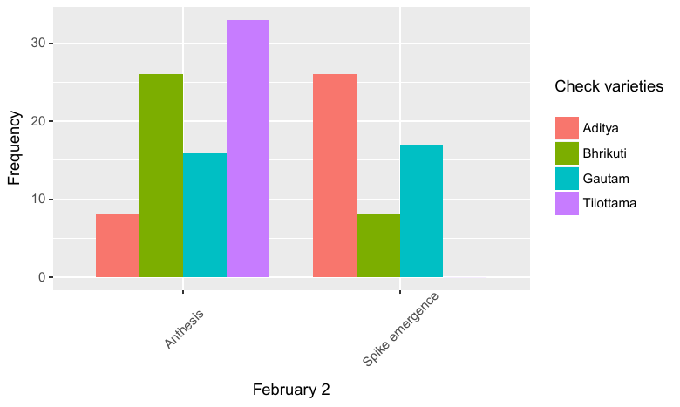
Results and Discussion
Figure: Frequency of check plots at different growth stages at February 2

Slide 31
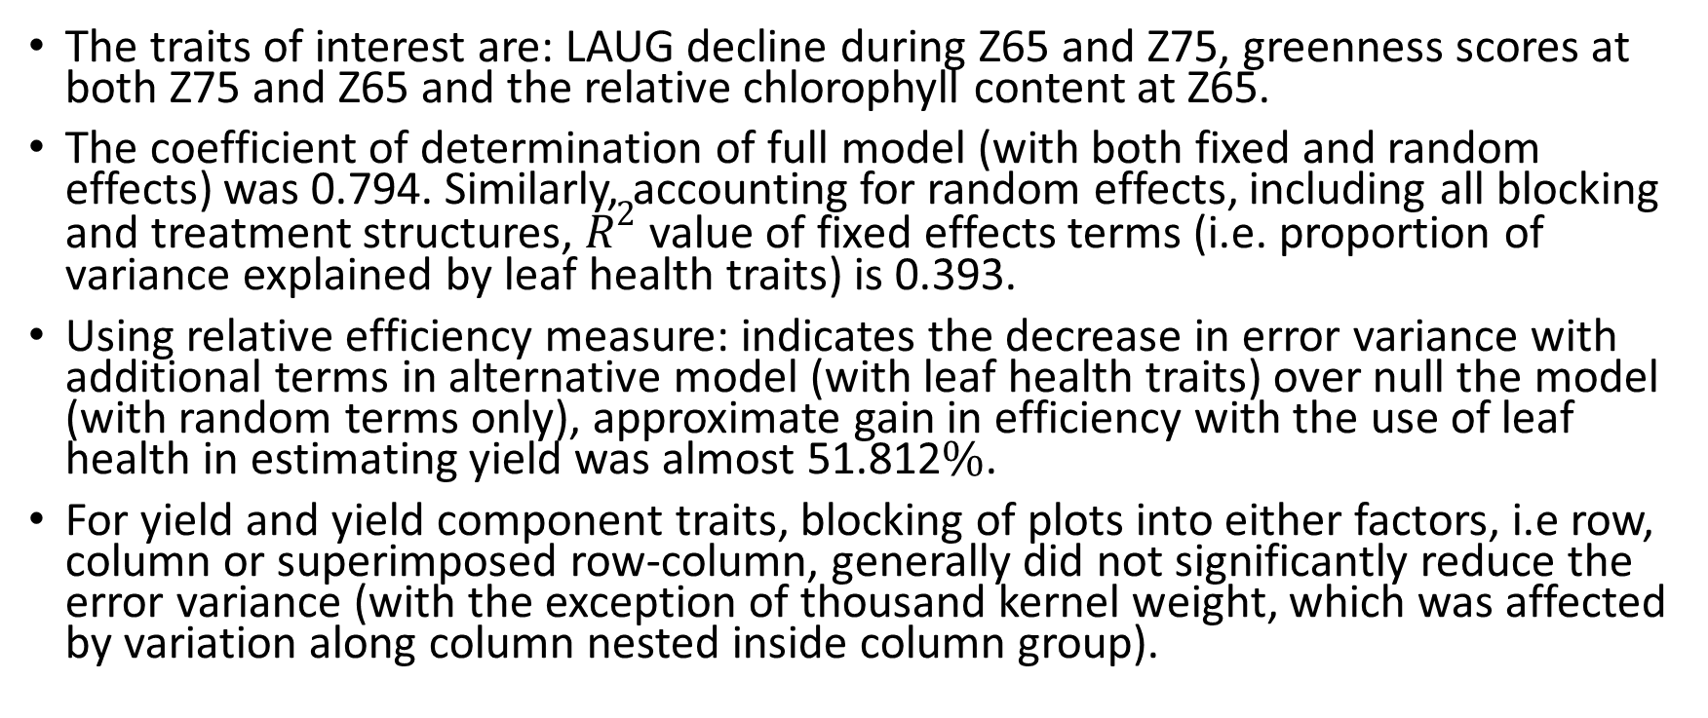
Conclusion
The traits of interest are: LAUG decline during Z65 and Z75, greenness scores at both Z75 and Z65 and the relative chlorophyll content at Z65.
The coefficient of determination of full model (with both fixed and random effects) was 0.794. Similarly, accounting for random effects, including all blocking and treatment structures, $R^{2}$ value of fixed effects terms (i.e. proportion of variance explained by leaf health traits) is 0.393.
Using relative efficiency measure: indicates the decrease in error variance with additional terms in alternative model (with leaf health traits) over null the model (with random terms only), approximate gain in efficiency with the use of leaf health in estimating yield was almost 51.812$\%$.
For yield and yield component traits, blocking of plots into either factors, i.e row, column or superimposed row-column, generally did not significantly reduce the error variance (with the exception of thousand kernel weight, which was affected by variation along column nested inside column group).

Slide 32
Acknowledgements
Major Advisor: Prof. Madhav Prasad Pandey, PhD
Member of advisory committee
Dean, Mentors
Batch mates, open-source computing community

Slide 33
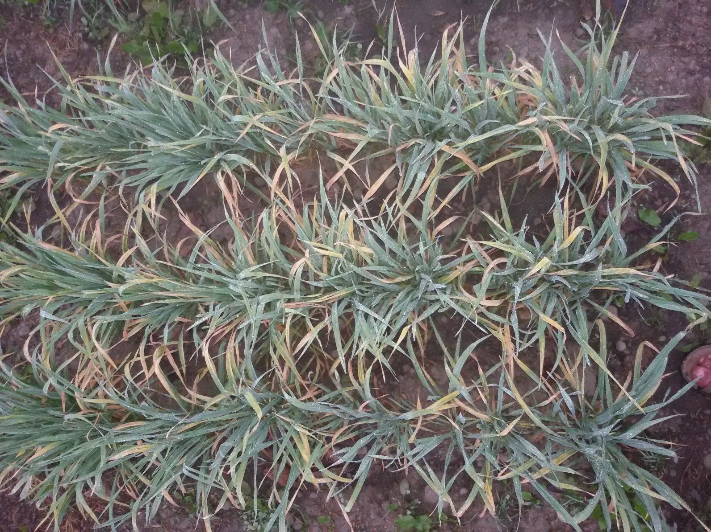
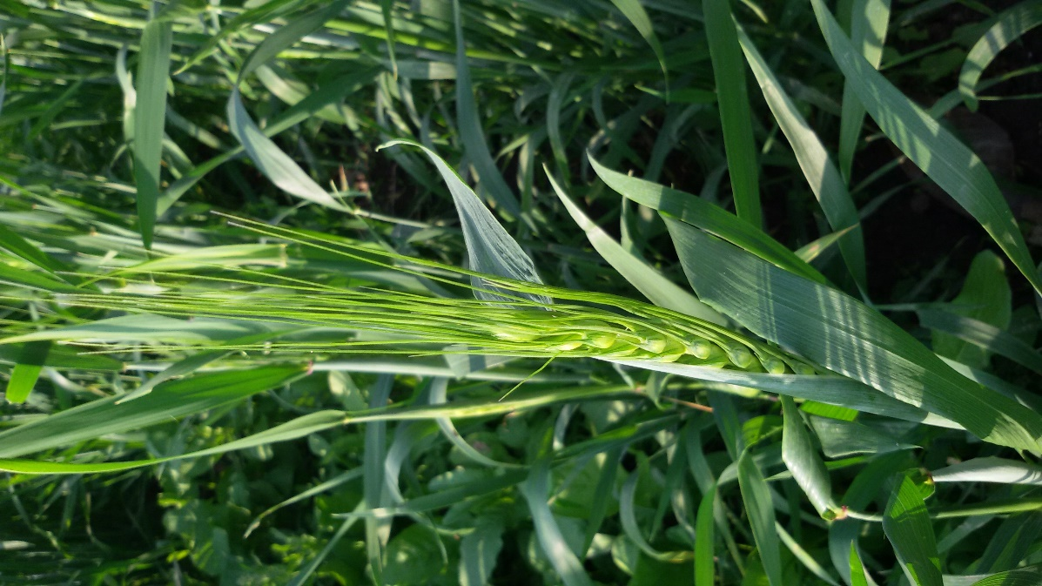
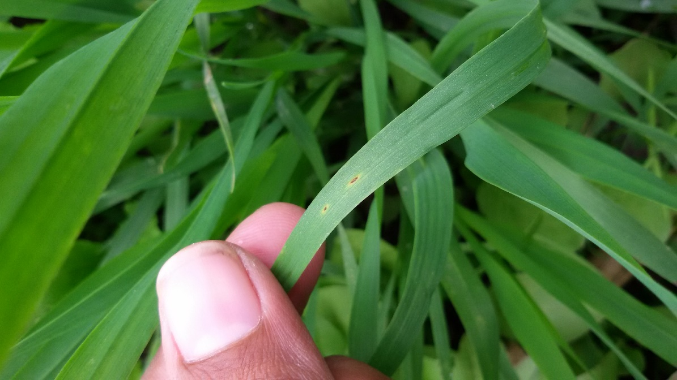
Field work glimpses

Slide 34
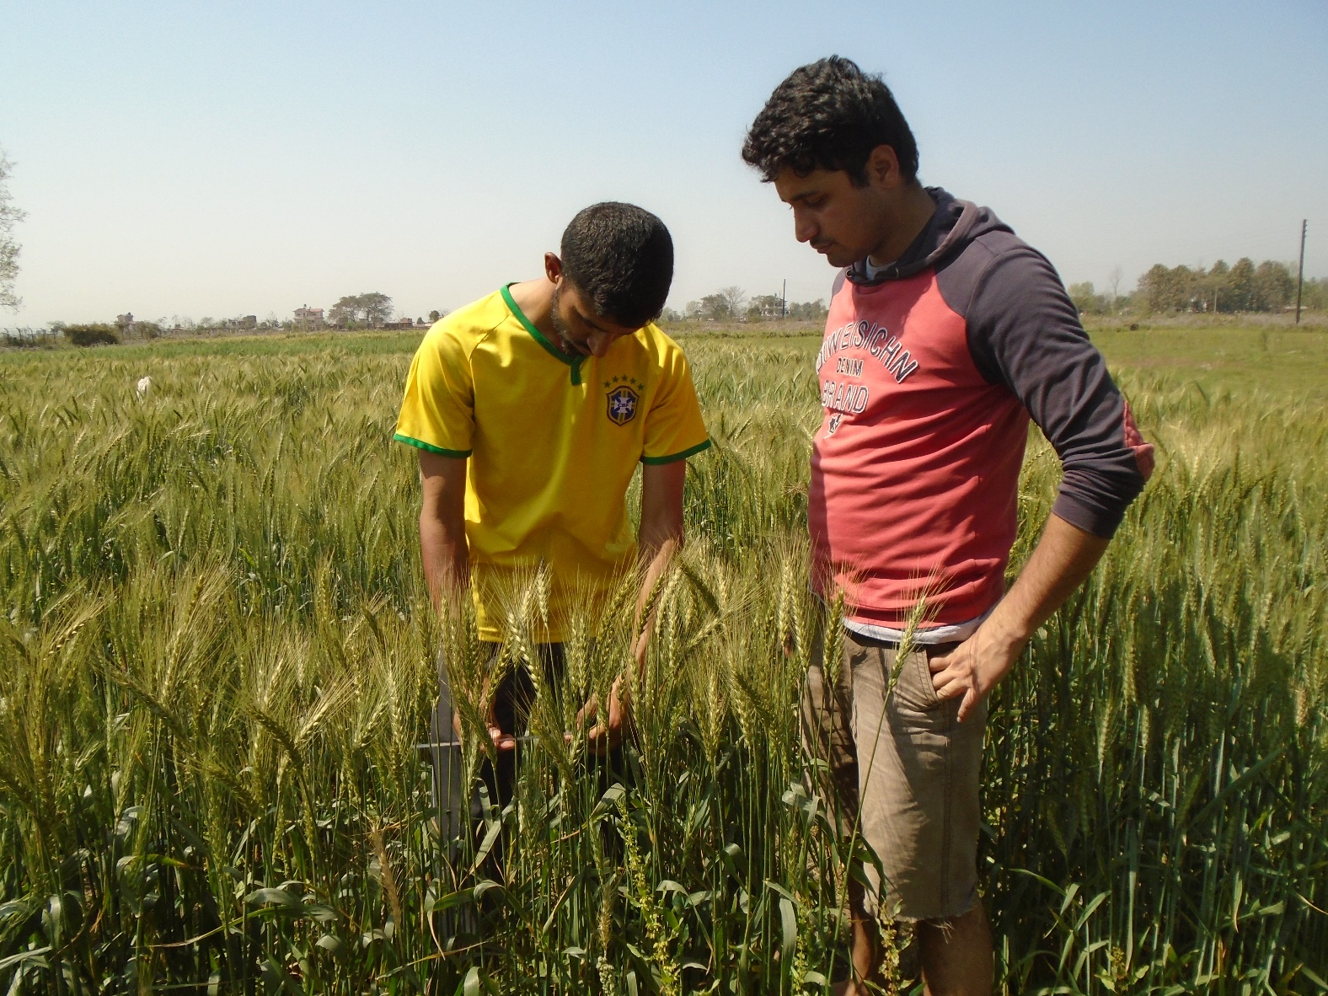
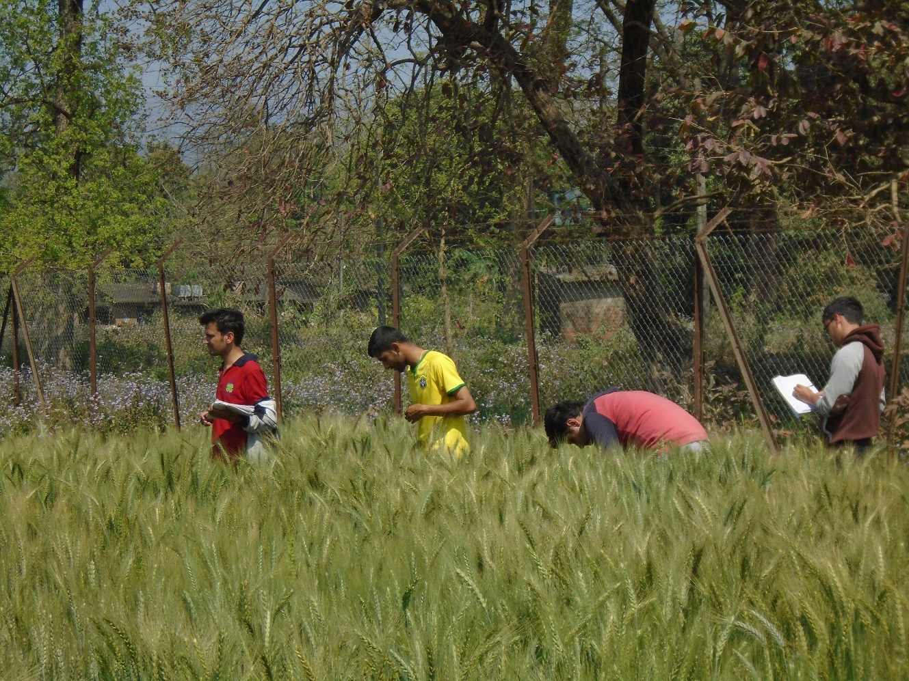
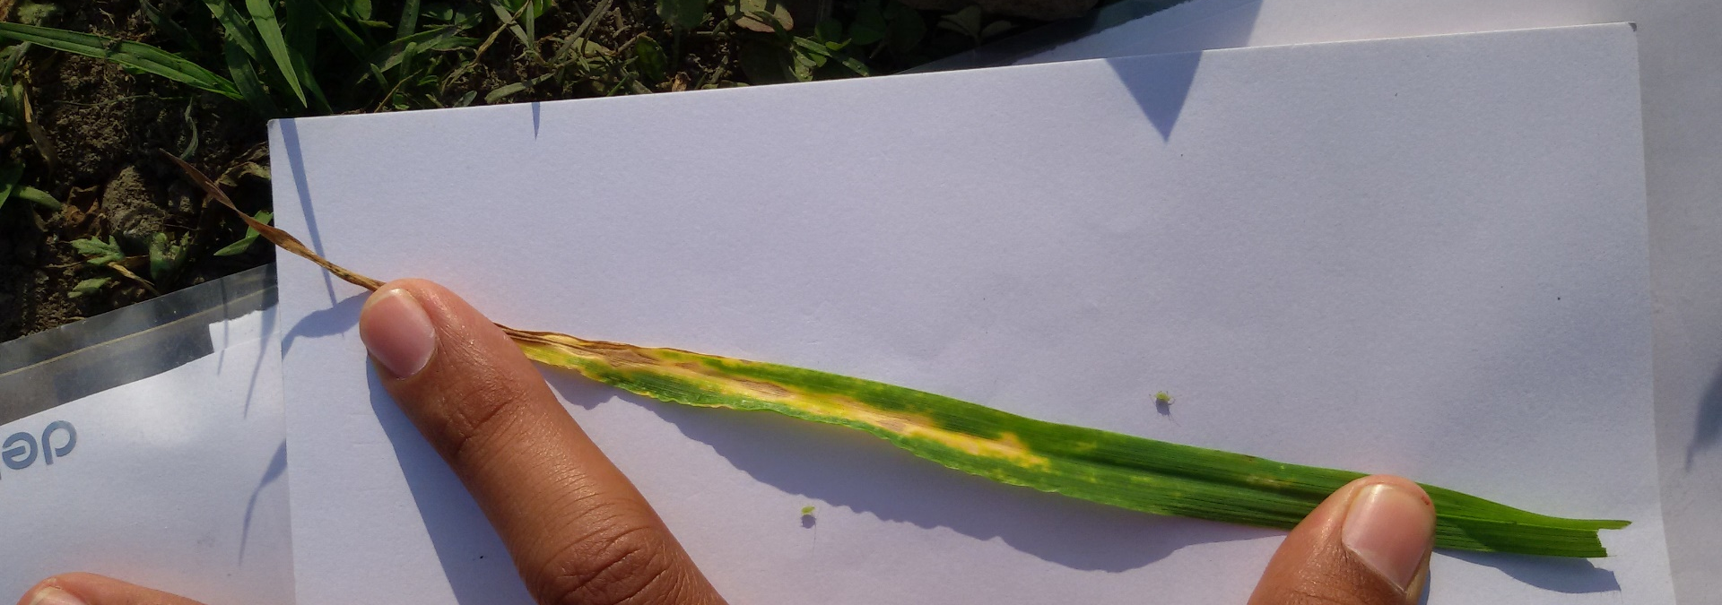
Field work glimpses

